Slide 1
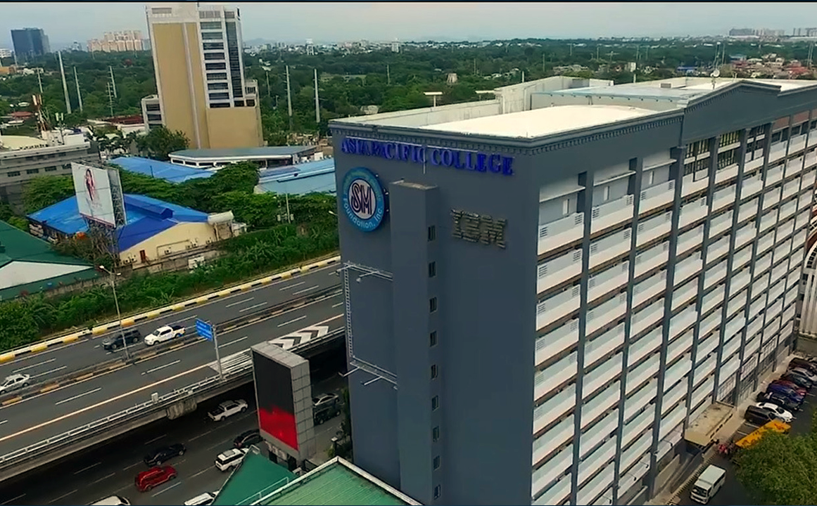
InnolabAMS: An Admission Management System for Elementary and Junior High School Institutions in the Philippines

Slide 2
Contributions
Adviser
Mr. Jojo F. Castillo
Members
Reycel John Emmanuel Carcueva
Initial github setup, Figma prototype, ERD, Update Use Case Diagram, Issues and PR.
James albert David
Update Fully Dressed, Update Activity Diagram, Login, Issues and PR.
Reejay Salinas
Manage Inquiry Act. Diagram, ERD, Register prototype, Issues and PR.
Althea sarmiento
Manage Scholarship Act. Diagram, DFD, Register prototype Issues and PR.
Matthew Paren
Update Test Case, PPT

Slide 3
Comments Matrix
Mr. Sean Sanchez
Can the submit application and process application Usecase be combined into one usecase “Manage Application”? | We combined the use case into just one. Instead of having use cases such as Submit Application and Process Application, we combined it and name the use case Manage Application, same goes to Submit Inquiries and Send admission details, we combined it and name the use case Manage Inquiries.
What is the goal of the registrar in your system? | We put the registrar as our actor just to have an end goal of the process, they can check the processed application to proceed with their process. But since, the registrar has limited actions we distinguished the Registrar from the actors.
You only have 2 main processes first is the manage application and then the generate of reports. The you have to have at least 5 major processes | We added the Manage Account and Mange Scholarship to our major processes.
Is the configure system uses part of the scope? | The “configure the system” use case part of the system but it is not part of the process, so we will also remove this use case.

Slide 4
Comment Matrix
Mr. Gonzalo Gumogda
Is the registrar the right actor for this system? | We updated our use cases by just focusing on the three main actors “Admission Officer”, “Applicant” and “Lead”.
The contents of the Alternative flow should be an alternative way to get to the main goal. (should be the same as the basic flow) | We added alternate some alternate flows in some use cases such as Manage Application and Manage Account.
The Login DFD needed to be fixed. Usually, there will be 3 login attempts before it goes to the error login or reset password. | We also removed the Login activity diagram and make it as part in every use cases.
In the use case submit application separate the inquire and application into 2 deferent use case. Then the application use case should be an extension of the inqure usecase. | We separated the use case and make the Manage Inquiries as extended of Manage Application.

Slide 5
Use case diagram

Slide 6
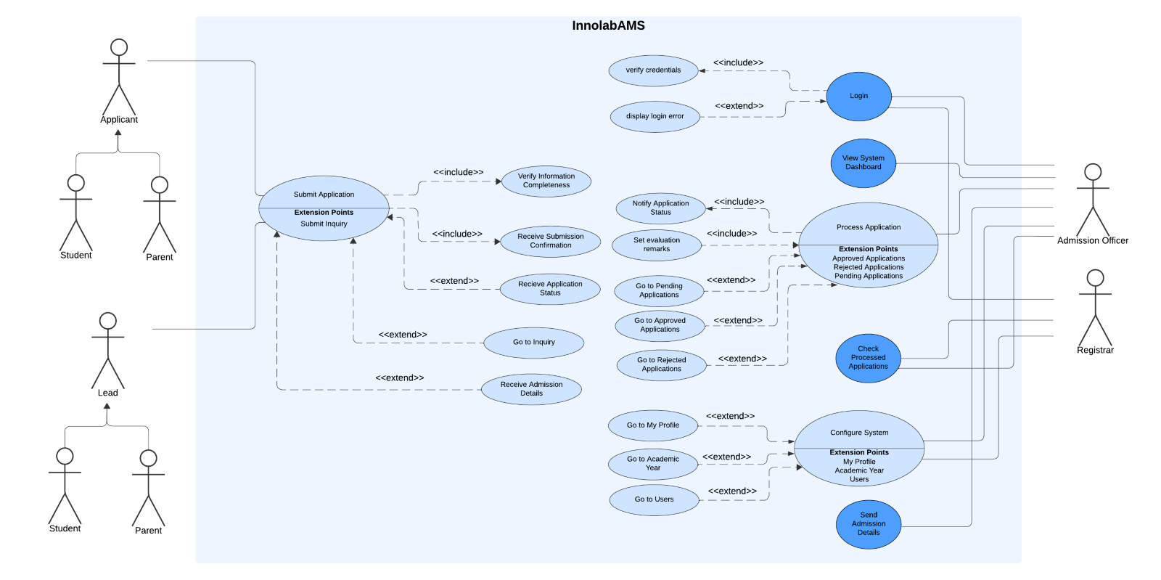
Before

Slide 7
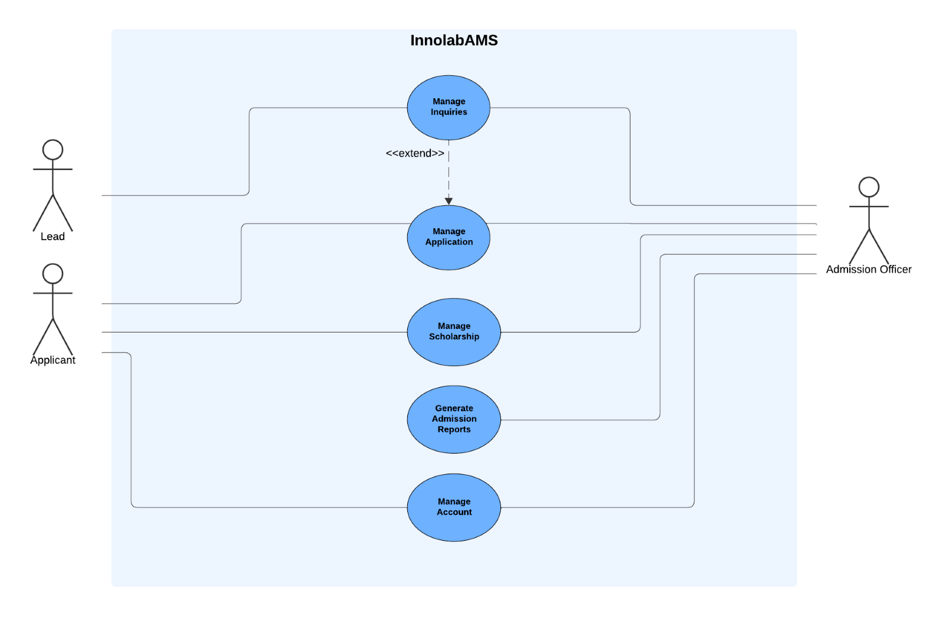
After

Slide 8
Fully dressed use case

Slide 9
Use Case ID | UC_1
Use Case Name | Manage Inquiries
Date created: | 10-7-2024
Description: | This use case allows the Admission Officer to manage inquiries from prospective students or their guardians. They can send information about the admission requirements, tuition fees, scholarships, and school newsletters.
Primary Actor | Lead Admission Officer
Secondary Actor | Mail Service
Triggers | A lead accesses the online admission login page. The Admission Officer logs in to the system and navigates to “Inquiries” module.
Included use cases:
Preconditions: | The Admission Officer must be logged into the system. An inquiry must be submitted and available in the system.
Postconditions: | The admission details and newsletter have been sent to the lead. The lead receives the admission details via email.
Main Success Scenario (or Basic Flow): | The lead clicks the “Submit Inquiry”. The actors fill in all the fields (e.g., personal details, contact information, inquiry) The lead submits the inquiry by clicking the button “Submit” The Admission Officer enters the admission module interface The Admission Officer navigates to the Inquiries item from the admin panel. The system displays all the new inquiries. The Admission Officer selects an inquiry that needs to be processed. The system displays the full details of the inquiry. The Admission Officer can navigate to the lead’s additional information. The Admission Officer clicks the ‘Send Admission Details button’ The Admission Details will pop up and the options are displayed (eg. Admission Requirements", "Tuition Fees", "Financial Aid/Scholarship Opportunities", "Campus Tours", "Programs”). The Admission Officer clicks what admission details need to be sent on the check box. The selected option is highlighted The actor clicks confirm The admission details are confirmed and sent through email to the lead. The system changes the inquiry status to “Responded”
Extensions: | 6.1. If no new inquiries are present in the system. a. The system displays a message indicating that no new inquiries are available. Use case ends
Notes:
“Let’s start with **Manage Inquiries**. Here, we document how Admission Officers engage with prospective students. It covers everything from receiving inquiries to providing timely responses. This part also includes how we distribute relevant information, ensuring prospective students get a clear picture of the institution and its offerings.”

Slide 10
Use Case ID | UC_2
Use Case Name | Manage Application
Date created: | 10-7-2024
Description: | This use case allows the Admission Officer to process applications by evaluating the application, setting remarks, updating and notifying applicants of their application status.
Primary Actor | Applicant Admission Officer
Secondary Actor | Mail Service
Triggers | An applicant accesses the online admission login page. The Admission Officer needs to process an application.
Included use cases:
Preconditions: | The Admission Officer must be logged into the system. The Applicant must be logged into the system The application must be submitted and available in the system.
Postconditions: | The applicant has successfully submitted their application. The application status is updated with the evaluation remarks given. The applicant is notified of their application status via email.
Main Success Scenario (or Basic Flow): | The applicant accesses the “Personal Information” item in the applicant panel. The system displays the current information that has been saved by the applicant. If the system did not detect an information, from the applicant it will display a button. The applicant clicks the button “Add my Personal Information” The system displays the Personal Information form. The applicant fills in all the required fields. The system will validate information completeness. The applicant clicks “Save” to save the information. The system saves the information. The applicant accesses the “Educational Background” item in the applicant panel. The system displays the current information that has been saved by the applicant. If the system did not detect an information, from the applicant it will display a button. The applicant clicks the button “Add my Educational Background”. The system displays the Educational Information form. The applicant fills in all the required fields. The system will validate information completeness. The applicant clicks “Save” to save the information. The system saves information. The applicant accesses the “Family Information” item in the applicant panel. The system displays the current information that has been saved by the applicant. If the system did not detect an information, from the applicant it will display a button. The applicant clicks the button “Add my Family Information”. The system displays the family information form. The applicant fills in all the required fields. The system will validate information completeness. The applicant clicks “Save” to save the information. The system saves information. The applicant accesses the “Documents” item in the applicant panel. The system displays the current information that has been saved by the applicant.
Notes:
“Next, we have **Manage Applications**. This use case details the full workflow, from application submission to review and updates. Here, we dive into evaluation procedures, documenting every step, and show how Admission Officers add their remarks. It’s like having a ‘step-by-step’ guide for managing applications seamlessly.”

Slide 11
Main Success Scenario (or Basic Flow): | If the system does not detect any information, from the applicant it will display a button. The applicant clicks the button “Add my Documents” The applicant uploads all required supporting documents (eg. Form 137, PSA, Transcript of Record) The system will validate information completeness. The applicant clicks “Save” to save the information. The system saves information. The system redirects to the “Additional Information” item in the applicant panel. The system displays the current information that has been saved by the applicant. If the system did not detect an information, from the applicant it will display a button. The applicant clicks the button “Add my Additional Information” The applicant fills in all the required fields. The system will validate information completeness. The applicant clicks “Save” to save the information. The system saves information. The system detects if all the items are completed. The actor reviews and clicks the button “Submit” to finalize the application. The system displays a confirmation message on the screen, and a confirmation email is sent to the applicant. The admission Officer enters the admission module interface The admission Officer navigates to the Applications from the system. The system displays all the new applications. The admission Officer selects an application that needs to be processed. The system displays the full details of the application, including the submitted documents and necessary information. The admission Officer evaluates the application to ensure all required documents and information are provided and meet the necessary criteria. The admission Officer can navigate to the applicant’s additional information. The admission Officer adds evaluation remarks to the application. The admission Officer updates the application status (e.g, Approved, Rejected, Pending) The admission Officer displays action confirmation. The admission Officer clicks confirm. The system saves the updated application status and remark to the application. The system sends automated email to applicant about the status of their application The system automatically moves the application to the destined status (Accepted, Rejected, Pending).
Alternate Flow: | 10, 20, 31, 41, 50a. If the User wants to get back to the previous item, they can click the “Previous Button” 58a. If the admission officer wants to get back to the applications item, they can click the “Back Button”
Extensions: | 51.1. If the system identifies missing documents during evaluation. a. The system prompts the admission officer to send a notification to the applicant to complete their application. b. The application status remains unchanged until the documents are provided. 55.1. If an error occurs while updating the application status. The system displays a failure message and suggests actions to retry Use case ends

Slide 12
Use Case ID | UC_3
Use Case Name | Manage Scholarship
Date created: | 10-20-2024
Description: | This use case describes the process by which the Applicant and Admission Officer manages scholarships, including submitting, assigning, editing, deleting scholarships.
Primary Actor | Admission Officer Applicant
Secondary Actor | Mail Service
Triggers | The Admission Officer accesses the scholarship management module. The Applicant accesses the scholarship management module.
Included use cases: | None
Preconditions: | The Admission Officer must be logged into the system. The applicant must be logged into the system. The applicant must be admitted or accepted.
Postconditions: | The scholarship information is updated, created, or deleted in the system. Applicants receive notifications about the scholarship status
Main Success Scenario (or Basic Flow): | The applicant accesses the “My Scholarship” module in the applicant panel. The system displays the current scholarship application that has been submitted by the applicant. If the system did not detect a scholarship application, from the applicant it will display a button. The applicant clicks the button “Apply Scholarship” The system displays Scholarship Application form. The applicant can choose if they want to fill out the application form or submit endorsement letters. The system validates information completeness The applicant clicks “Submit my Application” button The system saves the information. The admission officer logs into the system The system retrieves the data from the applicant’s account. The system displays the data from the scholarship application form The admission officer selects an application. The system displays full view of the application The admission officer clicks the dropdown “Assign Scholarship” and choose what scholarship type does the applicant qualify (eg. Public School, Financial-based, Academic Excellence). The system displays the amount of discount for the type of scholarship that was applied The admission officer confirms the action. The system saves the updates. The system will send notification to the applicant information about the scholarship application.
Extensions: | 7.1. If the system detects that the scholarship application is incomplete. a. The system displays a message to the applicant indicating the missing information or documents and prompted to complete the application. b. The application status remains unchanged until the documents are provided. 17.1. If an error occurs while assigning a scholarship. The system displays a failure message and suggests actions to retry. Use case ends
Notes:
“Now, onto **Manage Scholarships**. This use case is unique because it addresses the interaction from both student and officer perspectives. It’s a deep dive into handling scholarship applications, including specific evaluation criteria, ensuring both the students and officers have a smooth, understandable process.”

Slide 13
Use Case ID | UC_4
Use Case Name | Generate Admission Report
Date created: | 10-7-2024
Description: | This use case allows the admission officer to view various analytical reports, charts, and insights generated from the submitted applications. The dashboard provides an overview of key metrics and admission trends.
Primary Actor | Admission Officer
Secondary Actor | Data Visualization Tool
Triggers | The system automatically redirects to the system dashboard when the Admission Officer logs in. The Admission Officer wants to see an overview of the key metrics of the admissions from the system.
Included use cases: | None
Preconditions: | The Admission Officer must be logged into the system. The system must have an application data available for analysis.
Postconditions: | The reports are successfully displayed and viewed by the Admission Officer.
Main Success Scenario (or Basic Flow): | The system redirects the user to the system’s Dashboard. The system retrieves and displays data visualization of admission reports. The actor views different reports (e.g., total applications, application status, admission trends etc.). The actor can filter the data or adjust the time period to view specific trends. The system updates the dashboard based on the actor’s adjustments.
Extensions: | 2.1. If the system does not find any application data. a. The system displays a message indicating no data is available for analysis. b. The admission officer can select a different date range or check the system’s data input sources. Use case ends
Notes:
“Moving on, **Generate Admission Reports** covers the analytics and reporting capabilities. Here, we detail how data is compiled, and insights are generated, providing a foundation for tracking admissions trends and metrics. Think of it like creating insights from data analytics—each report offers actionable insights for decision-making.”

Slide 14
Use Case ID | UC_5
Use Case Name | Manage Account
Date created: | 10/25/2024
Description: | This use case describes the process of adding or registering an account and updating profile of the users.
Primary Actor | Admission Officer Applicant
Secondary Actor | None
Triggers | The Applicant needs to register an account. The Admission Officer or Applicant accesses the “Account” module. The admission Officer needs to add an admin account
Included use cases: | None
Preconditions: | The Applicant must have an access to the online admission Register page The actors are logged into the system.
Postconditions: | The applicant’s account is successfully registered The applicant’s account information is successfully updated in the system. The Admission Officer’s account has been added to the system
Main Success Scenario (or Basic Flow): | The applicant clicks “Submit Application” button The system displays the login form. If the applicant doesn’t have an account yet they should click the “Register” link. The system displays the register form. The applicant fills in the required field. The system validates the fields based on its field types and conditions. The applicant clicks “Register” The applicant will redirect to the application page. The Admission Officer navigate to the “Account” module at the top right corner of the users dropdown menu. The system displays account details and options for modifications. The Admission Officer selects an account to manage or update. The system displays the account information and modification options. The Admission Officer updates the relevant account information, such as roles or profile details. The system saves the changes made to the account.
Alternate flow: | 9a. The users can click their profile picture to redirect them to the account management module.
Extensions: | 13.1. If the system detects invalid input during the update process a. The system displays an error message indicating the specific issue. b. The actor corrects the error and resubmits the changes. Use case ends
Notes:
“Finally, **Manage Account** outlines user registration and account maintenance procedures. This section includes everything from security protocols to account updates. It’s like setting up robust account controls, similar to cybersecurity measures, ensuring accounts are secure and easily maintainable.”
"These use cases form the backbone of InnolabAMS, creating a clear and detailed map of user actions within the system, much like documentation in security protocols—each one detailed, precise, and accounting for every scenario. Thanks for your attention!"

Slide 15
Data flow diagram

Slide 16
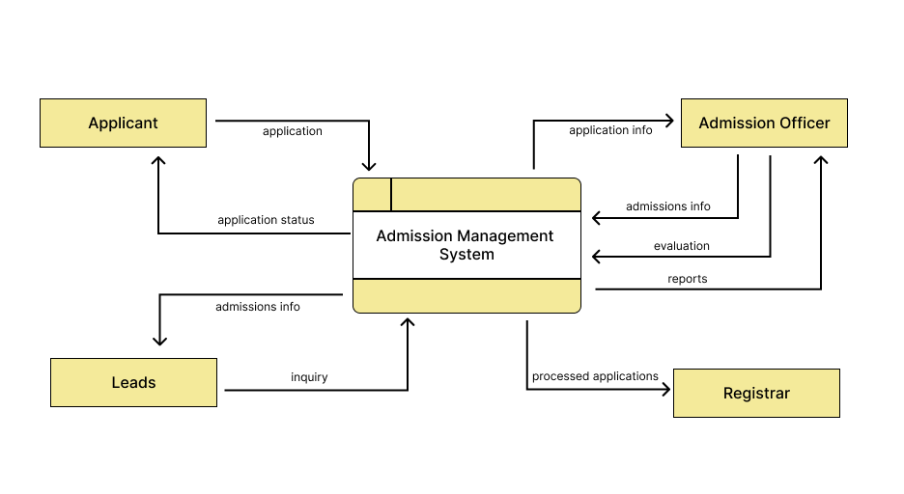
Context
Before

Slide 17
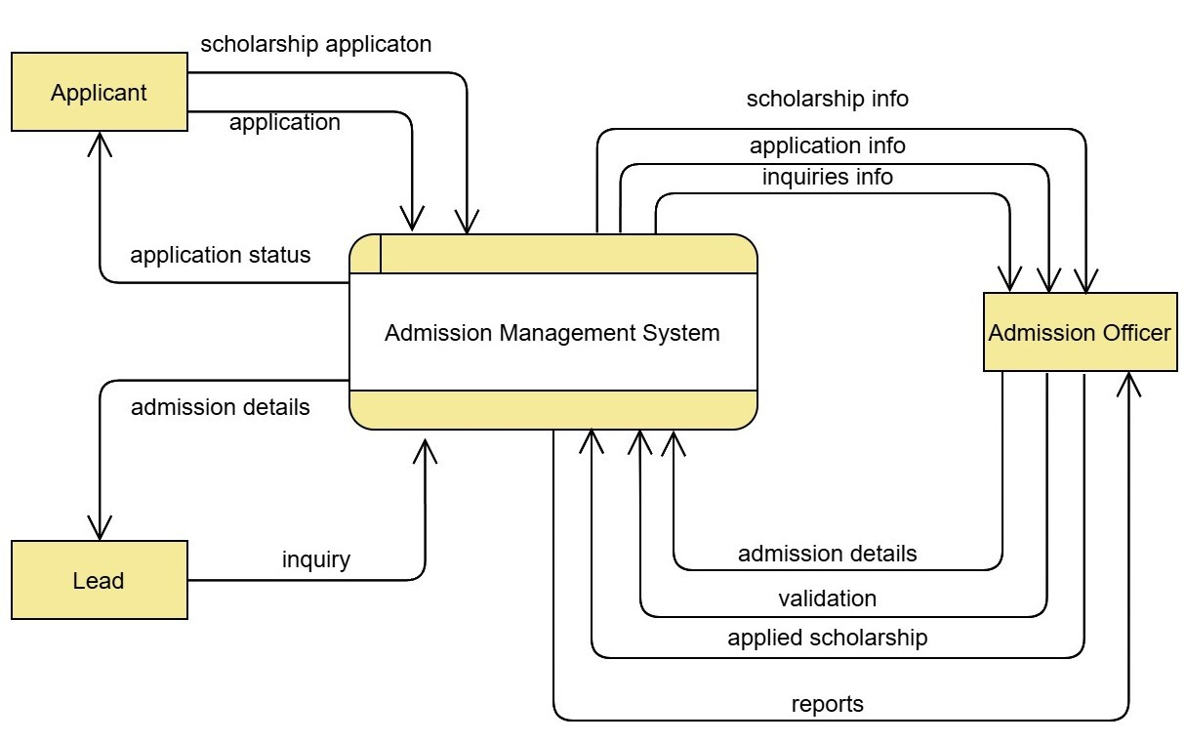
Context
After

Slide 18
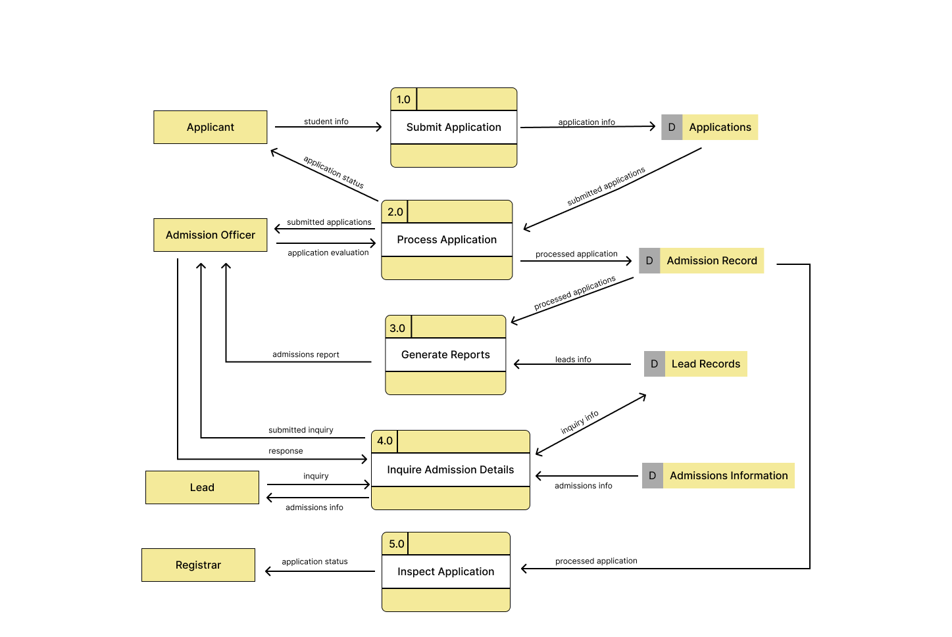
Level 1
before

Slide 19
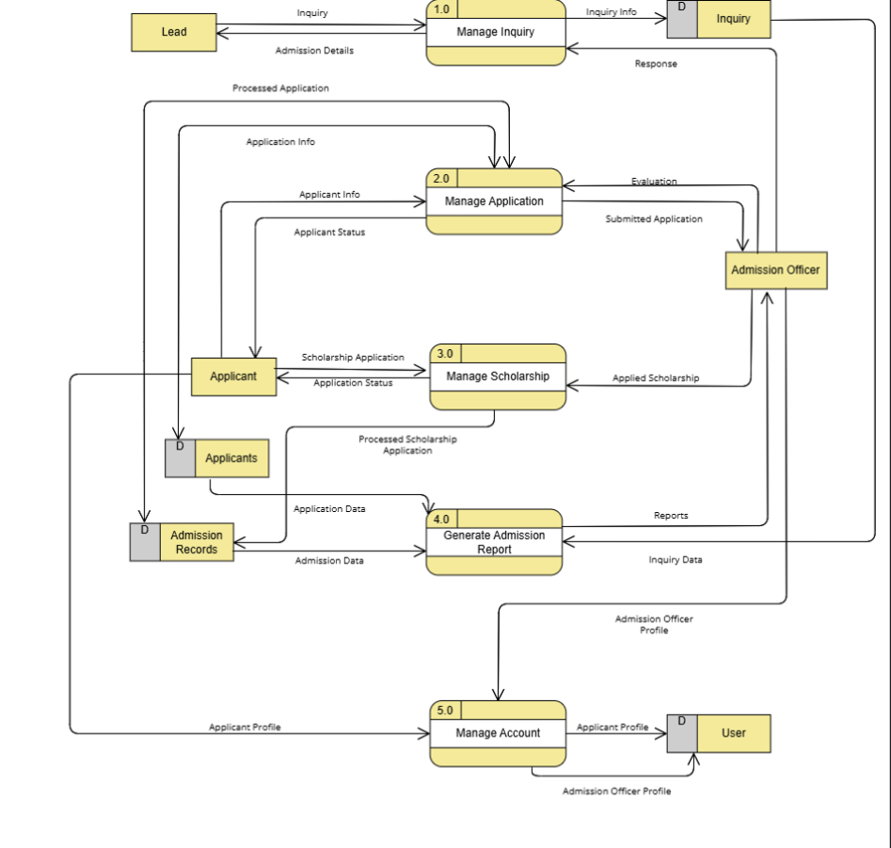
Level 1
after

Slide 20
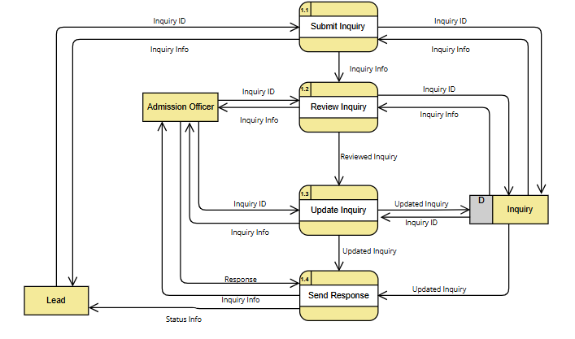
Level 2 Manage Inquiries

Slide 21
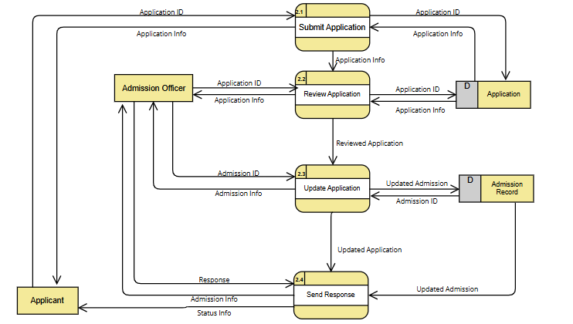
Level 2 Manage application

Slide 22
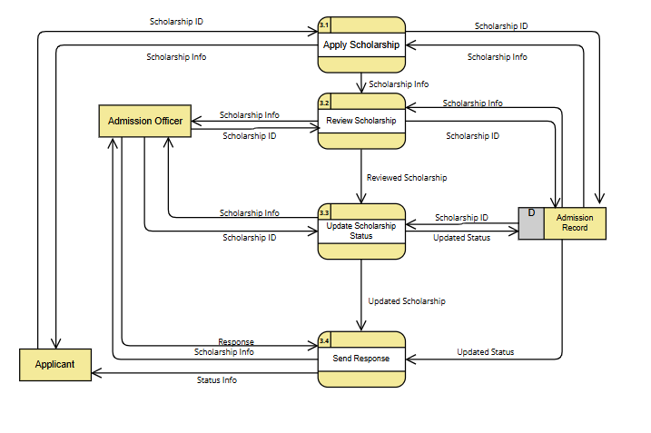
Level 2 manage Scholarship

Slide 23
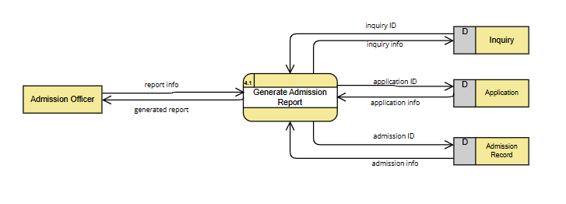
Level 2 Generate reports

Slide 24
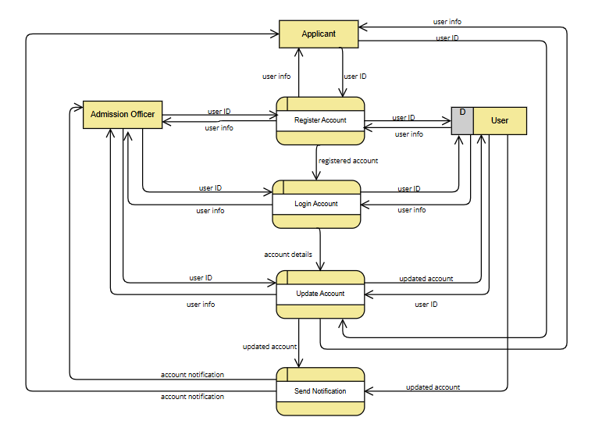
Level 2 inspect application

Slide 25
Activity Diagram

Slide 26
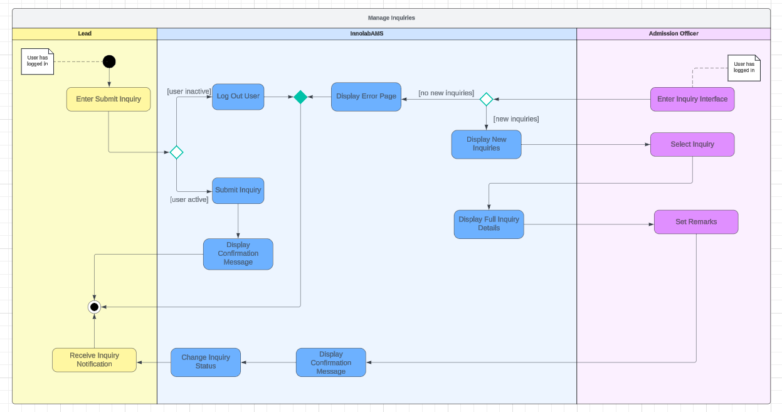

Slide 27
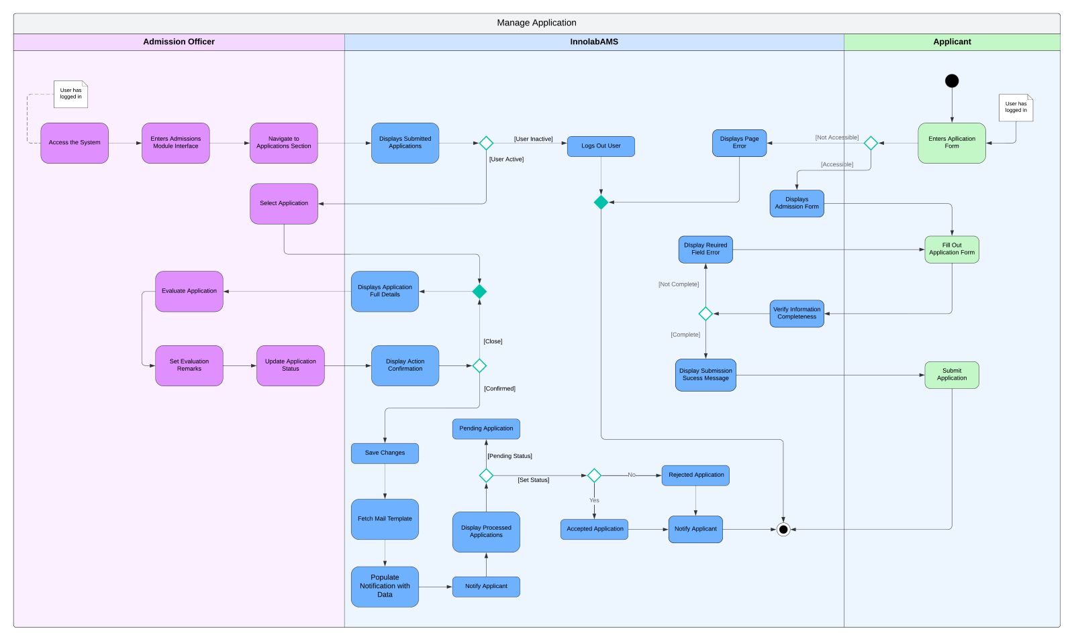

Slide 28
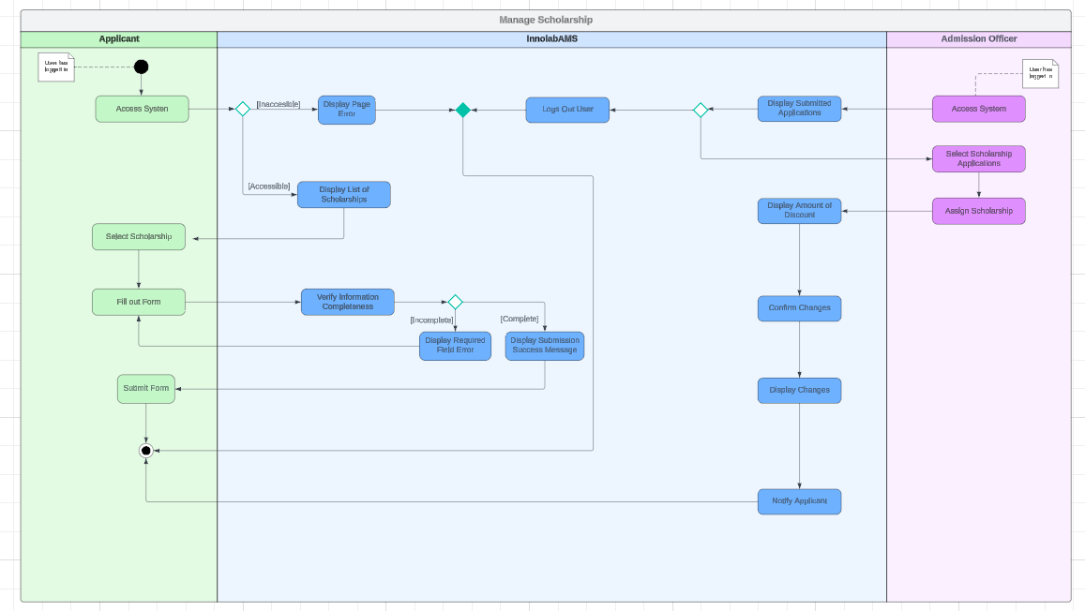

Slide 29
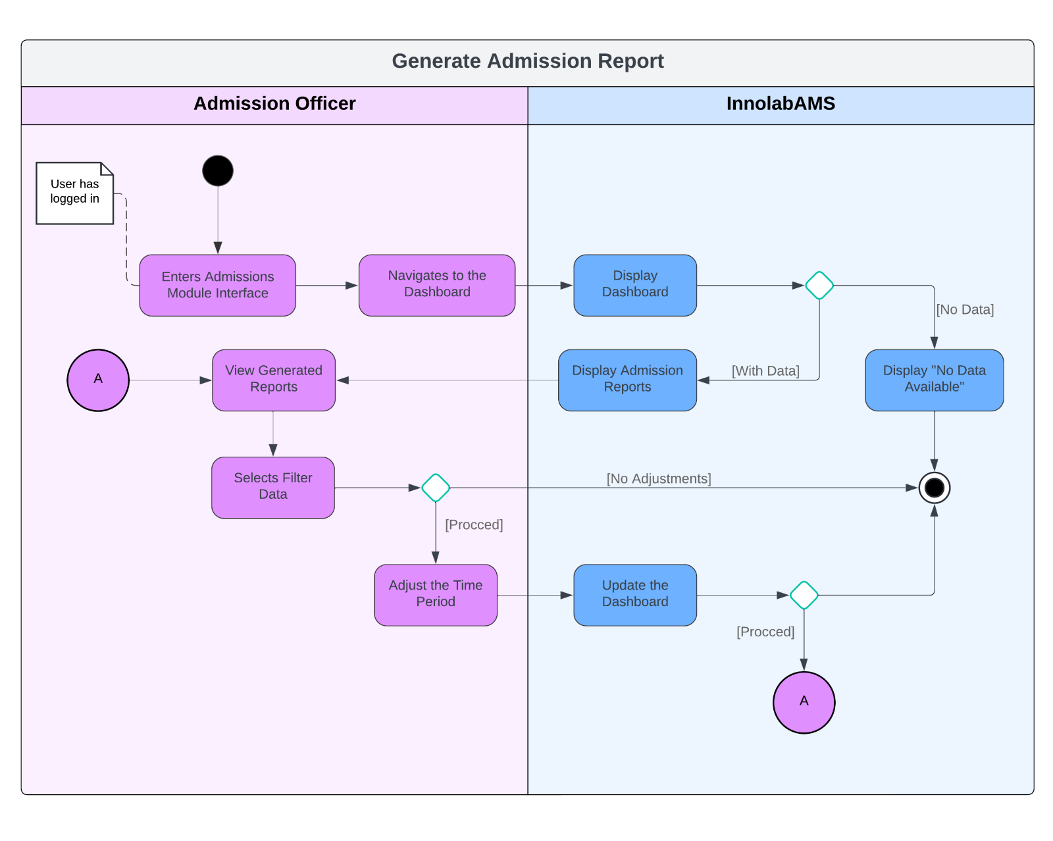

Slide 30
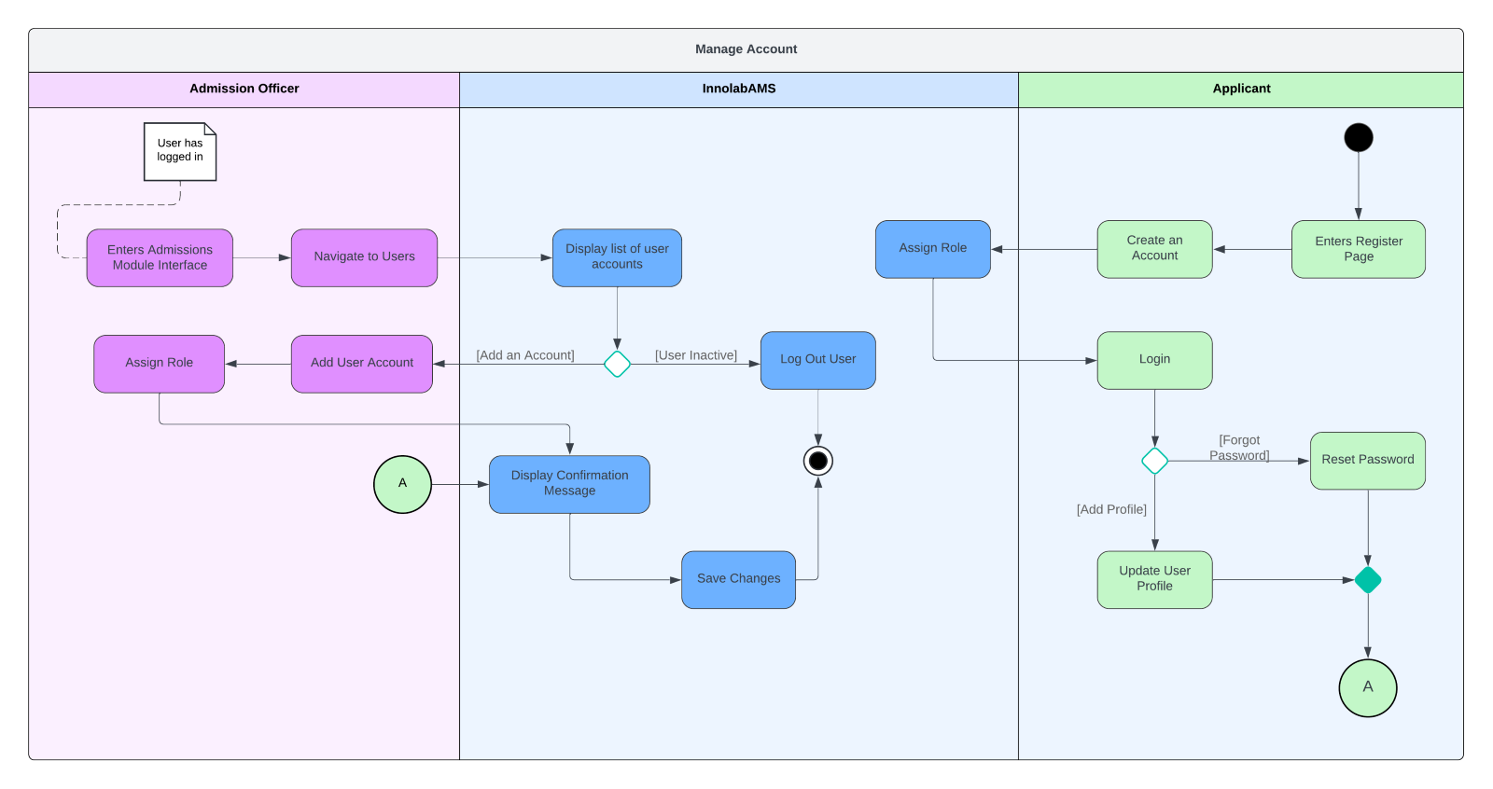

Slide 31
Entity relationship Diagram
https://asiapacificcollege.sharepoint.com/sites/InnolabSIS/Shared%20Documents/Forms/AllItems.aspx?id=%2Fsites%2FInnolabSIS%2FShared%20Documents%2FDiagrams%2FEntity%20Relationship%20Diagram%2Epdf&parent=%2Fsites%2FInnolabSIS%2FShared%20Documents%2FDiagrams&p=true&ga=1

Slide 32
Github repository and cloud hosted prototype
Github Repository Link:
APC-SoCIT/APC-2024-2025-T1-05-Admission-Management-System
Cloud Hosted Prototype Link:
https://squalid-spooky-wraith-g44rqr54r7jq39wg4-80.app.github.dev/
Sample Credentials: Email: test@example.com
Password: password

